Slide 1
Wide Awake: Autism and Sleep Challenges
March 29, 2021
Carrie Cuffman, MD
Developmental-Behavioral Pediatrician
Notes:
Advice on a 4y/o boy who needs deep pressure and tactile input from parents to fall asleep give themselves that input.
Can undiagnosed seizures, sleep apnea, or growing pains be cause for sleep problems?
Is there anything ASD-specific we need to ask for when seeking a sleep evaluation for our HFA adolescent/young adult kids?
Why does my son have a hard time staying asleep at night
Is is common for ind with asd to "reprocess" (sometimes at night), seeming to reenact the events/conversations of the day?
Weaning the pacifier for nap and bedtime in 2.5 year old. Should I do it? Or just let him have it?
Is melatonin safe to use for an extended period of time?
I was diagnosed as narcoleptic and was 35 years old before they figured out I needed a Bipap. I can now stay awake.

Slide 2
Learning Objectives
Identify why so many children with autism spectrum disorder (ASD) have problems with sleep
Learn how to pinpoint and address possible causes of your child’s sleep problems
Determine when to get a medical provider involved and how they can help

Slide 3
The Connection Between ASD and Sleep

Slide 4
percentage of children with ASD with sleep troubles
50-80%
Notes:
Research has shown that as many as 50-80% of children with ASD have trouble with some aspect of sleep. So if your child with ASD has trouble with sleep, you are not alone. Difficulties that children with ASD have include trouble falling asleep, resisting bedtime, preferring a later bedtime, waking up at night, restless sleep and waking early in the morning. Some children with ASD may also do unusual things in the sleep like sleep walking/wandering the house or banging their heads repetitively.

Slide 5
Sleep Trouble
Behavioral
Medical
Biological
Notes:
When I think about sleep troubles in children with ASD, there are 3 main categories that these fall into. BIOLOGICAL causes relate to differences in the brain chemistries and bodies of children with ASD that make sleep more difficult. These are changes that are related to ASD and are intrinsic to a child with ASD. Medical concerns are just that – medical problems that can cause trouble sleeping. These are not necessarily unique to children with ASD, but can happen in all children. Behavioral concerns are varied and vast in children with ASD around bedtime and during the night, and most of my talk will be focused on behavioral concerns.

Slide 6
Behavioral Causes
Occur due to a habit that interferes with good sleep
Notes:
Does not imply that your child is bad or behaving badly

Slide 7
Medical Causes
Reflux
Cough/asthma
Sleep apnea
Eczema
Dental problems
Restless leg syndrome
Seizures
Pain
Anxiety
Depression
Medications
Iron deficiency

Slide 8
Biological Causes: Hypotheses
Brain wave organization & maturation
Circadian-relevant genes
Abnormalities in melatonin
Arousal level and sensory hyper-reactivity
Notes:
Abnormally low melatonin levels/rhythms
Differences in brain wave organization & maturation
Anomalies in circadian-relevant genes
Abnormalities in melatonin
High-arousal/hyper-arousal/sensory hyper-reactivity
PMID: 28502070
Sleep in Children with Autism Spectrum Disorder
Margaret C. Souders,¹ Stefanie Zavodny,¹ Whitney Eriksen,¹ Rebecca Sinko,² James Connell,³ Connor Kerns,³ Roseann Schaaf,² and Jennifer Pinto-Martin¹

Slide 9
Being a Detective for your Child’s Sleep Problems
Behavioral

Slide 10
Analyzing Sleep Habits
Consistency in timing
Bedtime routine
Sleep environment
Daytime habits

Slide 11
Consistency in Timing
Bedtime and wake time at the same time each day (including weekends!)
Mealtimes at approximate same time each day
Naps at same time and not too late
Notes:
Don’t let your child sleep in more than an hour or two on the weekend

Slide 12
Bedtime Routine Tips
Short, just a few activities
15-30min (shorter for younger children)
Each activity should be easy and relaxing
Avoid screens!
Move toward the bedroom
Same each night
Notes:
Avoid: sports, homework, loud music, stimulating video games, roughhousing
Soothing activities: listening to music, reading, drawing, playing with a favorite toy
Relaxation techniques: deep breathing, progressive relaxation, guided imagery, sensory techniques

Slide 13
Bedtime routine visual schedule
From Autism Speaks Sleep Toolkit
Notes:
Some children with autism may benefit from a visual schedule of their bedtime routine to keep them on track and help them know what is coming next

Slide 14
Sleep environment
Temperature
Light
Comfort of bedding and pajamas
Noise
Scents
Objects in the room/bed
Other people in the room/bed

Slide 15
Daytime Habits
Physical activity
Light in the morning/dark in the evening
Caffeine
Napping
Use of the bed/bedroom
Stress/anxiety

Slide 16
Common Sleep Problems
Bedtime resistance & trouble falling asleep
Overnight awakenings
Early awakening
Sleep Trouble
Behavioral
Medical
Biological
Notes:
Why does my granddaughter rock in bed before sleeping

Slide 17
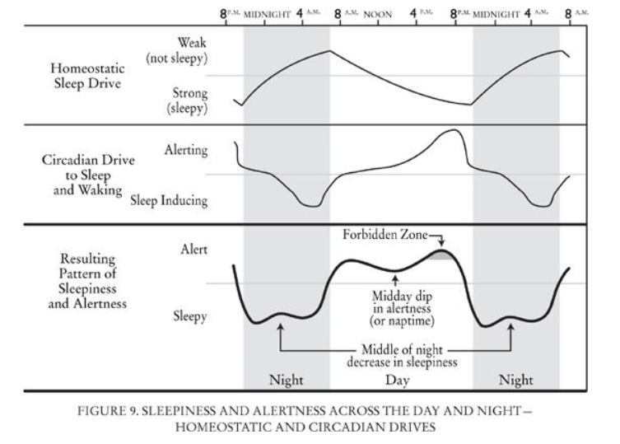
Bedtime Resistance/Trouble Falling Asleep
Behavioral
Wrong bedtime
No routine/routine not calming
Daytime habits
Sleep environment
https://doctorlib.info/pregnancy/sleep/10.html
Notes:
Why doesn’t my grandson just fall asleep when he is tired? Why does he fight it?

Slide 18
The Bedtime Pass
Good for “curtain calls” for preschool or older children
Behavioral
From Autism Speaks Sleep Toolkit
Notes:
Child receives the pass at bedtime
If still has the pass by morning, gets a small reward
If needs parent check-in, gives up the pass
After using the pass, parents should ignore bids for attention
If child leaves room after using pass, parent guide them back with as little interaction as possible
Can start with more than 1 pass

Slide 19
Bedtime Resistance & Trouble Falling Asleep
Medical
Anxiety, ADHD
Medications (stimulants, SSRIs)
Melatonin abnormalities
Biological

Slide 20
Using Melatonin
Doses 1mg – 5mg
Take 30-60min before bed
Helps set the sleep clock
Best when used with behavioral strategies
Helps with falling asleep more than staying asleep
Biological
Notes:
Doses 1mg – 5mg
Take 30-60min before bed
Is meant to help SET THE CLOCK not make the child drowsy
Works best when used with behavioral strategies
Helps with falling asleep more than staying asleep
What doses of melatonin seem to work with children. We first had success with 3mg, but it wore off.

Slide 21
Teenagers and Bedtime Problems
Same overall rules for sleep
“Clock” shifts in puberty to later sleep onset time
May need to delay bedtime by 30 min-1 hour
Still need ~9 hours of sleep
Consistency between weekdays and weekends is key!
Biological
Behavioral

Slide 22
Overnight awakenings
Sleep onset associations
Sleep environment
Daytime habits
Parasomnias
Nightmares/anxiety
Sleep apnea, reflux, eczema, etc
Behavioral
Medical
Notes:
Frequent sleep interruption where child wakes up into a crying fit and they are inconsolable - happens nightly.

Slide 23
Dealing with Sleep Associations
Teach your child to fall asleep on their own
Checking in:
say goodnight and leave and then come back and “check in” briefly
Lengthen time between visits over time
Not recommended for anxious children
Behavioral

Slide 24
Dealing with Sleep Associations
Fading parental presence:
Sit in the room while child falls asleep
Sit a little farther from the bed each night until you are in the hallway
Done when child can fall asleep with parent out in the hall mostly out of sight
Behavioral

Slide 25
Early Morning Awakenings
Behavioral
Bedtime timing
Daytime habits
Depression/anxiety
Normal sleeping pattern
Medical
Biological

Slide 26
Early Morning Awakenings
Give your child something to do on their own
Visual cues to help him/her know when it is ok to leave bedroom
Clock with red/green light
Stop sign on the door
Behavioral

Slide 27
Help! When to involve medical providers

Slide 28
Concern for Medical Cause of Sleep Disturbance
Reflux
Cough/asthma
Sleep apnea
Eczema
Dental problems
Restless leg syndrome/Periodic limb movement disorder
Notes:
Reflux – sour burps, chest pain
Cough/asthma – night coughing
Sleep apnea – snoring, gasping/pausing in breathing, daytime sleepiness
Eczema – itching/rash
Dental problems – behavior/eating changes
Restless leg syndrome/Periodic limb movement syndrome – complaints of leg discomfort in the evenings, extremely restless sleep; can be related to iron deficiency

Slide 29
Concern for Medical Cause of Sleep Disturbance
Seizures
Parasomnias (sleep walking, talking, night terrors)
Pain
Anxiety
Depression
Medications
Notes:
Seizures – excessive daytime sleepiness, seizure-like movements, AM headache, vomiting during sleep
Parasomnias – can sometimes be related to other sleep problems, so if persistent should be evaluated by a medical provider; important to make sure child is safe; particularly if your child moves the same way every time, etc talk to a medical provider to see if need to r/o that they may be seizures
Pain - anywhere! Growing pains, dental pains
Anxiety – more rigidity and outbursts
Depression – depressed mood, increased irritability
Medications – stimulants, SSRIs
Iron deficiency – can contribute to limb movements; picky diet, not eating meat

Slide 30
When Behavioral Interventions Aren’t Working
Tried behavioral interventions for 1-2 months without success
Medical prescribers can decide if medication indicated
Sleep psychologists can help fine-tune behavioral strategies

Slide 31
References and Resources
Solving Sleep Problems in Children with Autism Spectrum Disorders
Terry Katz, Ph.D. & Beth Malow, M.D., M.S.
Autism Speaks Toolkits:
ATN/AIR-P Sleep Strategies for Children with Autism
ATN/AIR-P Sleep Strategies for Teens with Autism
ATN/AIR-P Melatonin and Sleep

